Slide 1
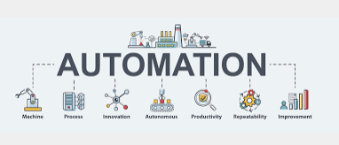


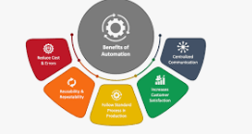
Roadmap 2024- OneID- digitalization of admissibility
Q1
Preparation Phase
Q2
Technology Assessment and Selection
Q3
Pilot and Testing
Q4
Long-Term Strategy and Innovation
Assessment and Inventory: Conduct an inventory of current analytics and reporting capabilities, data sources, and infrastructure.
Goal Setting: Define specific objectives for the cloud migration, including performance, scalability, and cost objectives.
Technology Assessment and Selection
Evaluate and select the appropriate technology platforms for the digital identity wallet and the integration with airline systems.
Choose platforms that support secure and efficient management of VCs.
Pilot and Testing
Conduct a pilot project with a select group of passengers to test the functionality and efficiency of the digital identity wallet in the check-in process.
Refine the system based on feedback and test results.
.
Long-Term Strategy and Innovation
Develop a long-term strategy to incorporate emerging technologies, such as blockchain and biometrics, to further enhance the digital admissibility process.
Stay updated with industry trends and adjust the roadmap as necessary to incorporate new innovations and improvements.

